Slide 1
Online Job Portal System
Pafkiet City Campus
Final Year Project.
Created By Name: Shaikh Faizan Hassan
Student ID: 11076
Email: sfh8881212@gmail.com Contact: 03363204173

Slide 2
Objective
Project is to provide the information about new jobs. A user can search jobs according to their location or their
skills. It provide the resume tips and interview tips which is useful to provide the guideless to the user. A
company or organization can post the new jobs which is store in the new job database and according to this
new database employer and jobseeker or employer can search this new jobs.

Slide 3
Job Seeker Area
This module provides functionalities for job seekers. Applicants can post their resumes with personal and
professional details. They can also update the resume as frequently as required. The applicant can also browse
through the present vacancies available. Job seekers can also get mail alerts when their resumes are selected by
employers.

Slide 4
Employer Area
This module provides functionalities related to employers. Employers can post vacancy details and update the
details as and when necessary. Employers can search through applicant resumes based on different criteria

Slide 5
Administration Area
This module provides administrator related functionalities. Administrator manages entire application and
maintains the profiles of applicants and employers.

Slide 6
Final Year Project 1 (YFP)
Administration Section
Manage complete jobseeker section. Like: activate/deactivate/delete/ edit jobseeker’s information.
Admin user can view the jobseeker’s applications for each job.
Manage complete employer section. Admin user can activate/deactivate/delete/ edit company information
Manage posted jobs. Like: activate/deactivate/delete/edit posted job.
Manage whole website content. Dynamic CMS is included to manage the content of the website.
Admin user can add/edit countries, cities, salaries range, qualification, institutes, job industries, website ads

Slide 7
Final Year Project 1 (YFP)
Job Provider Section
Add / Edit company’s profile
Post new job vacancies
Edit / Deactivate posted jobs
job provider can see the list of jobseekers who has applied for the job
Job provider can see and download the jobseeker’s resume
Job provider can send message to any job seeker

Slide 8
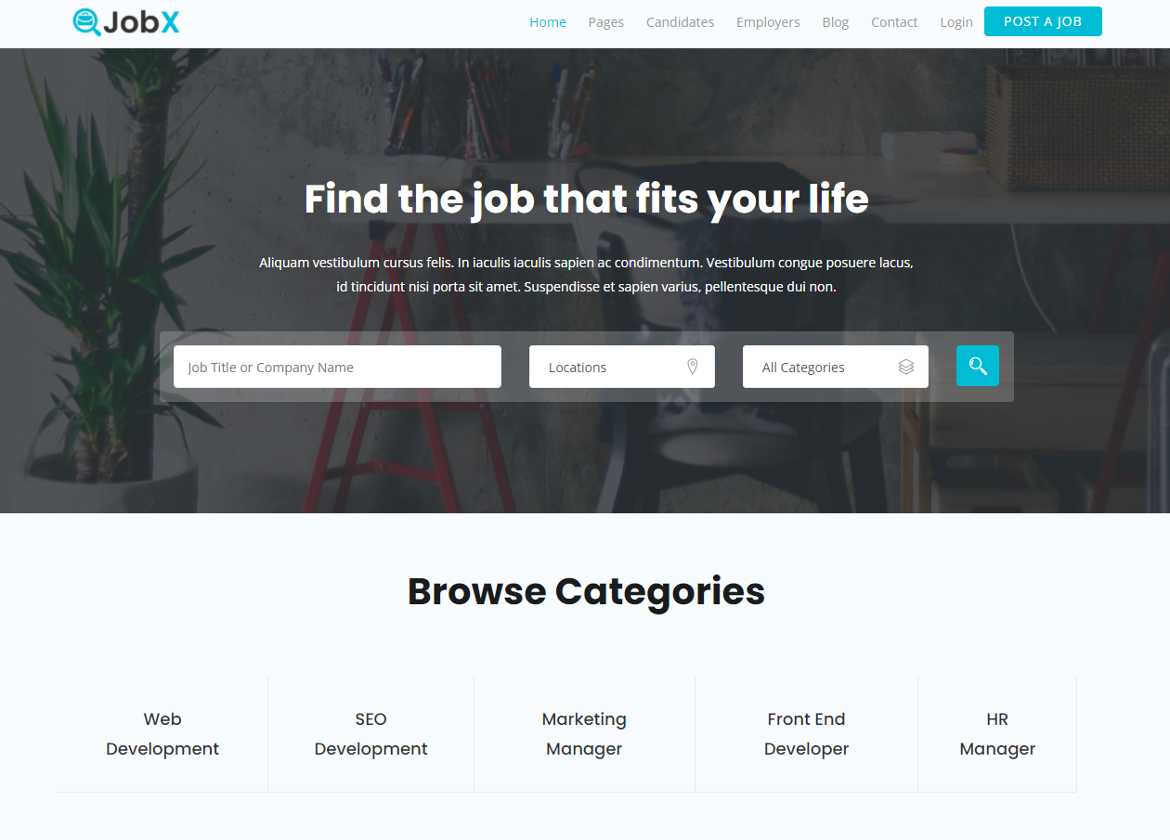
Home Page

Slide 9
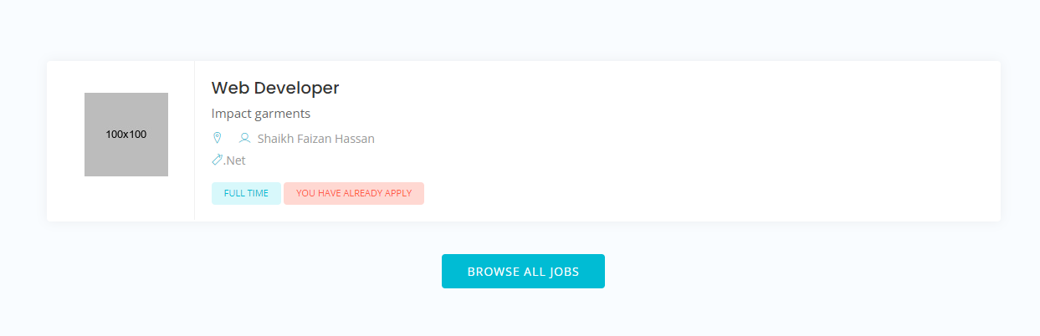
Posted Job

Slide 10
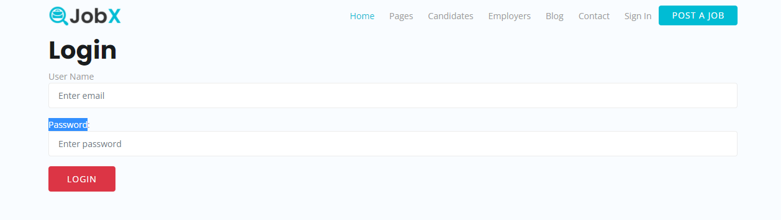
Job Seeker Login Page

Slide 11
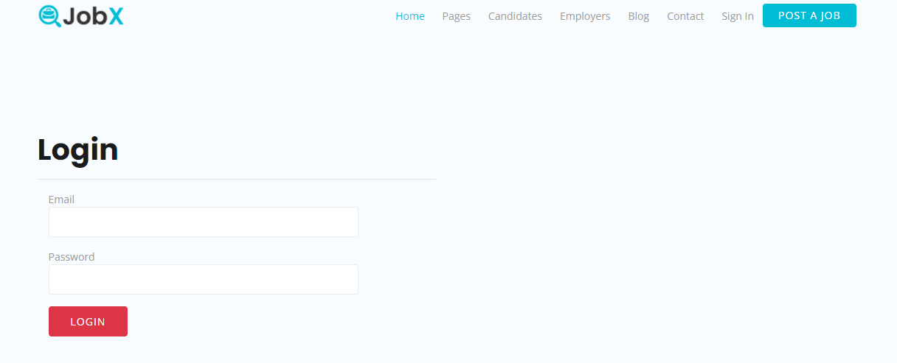
Admin Login

Slide 12
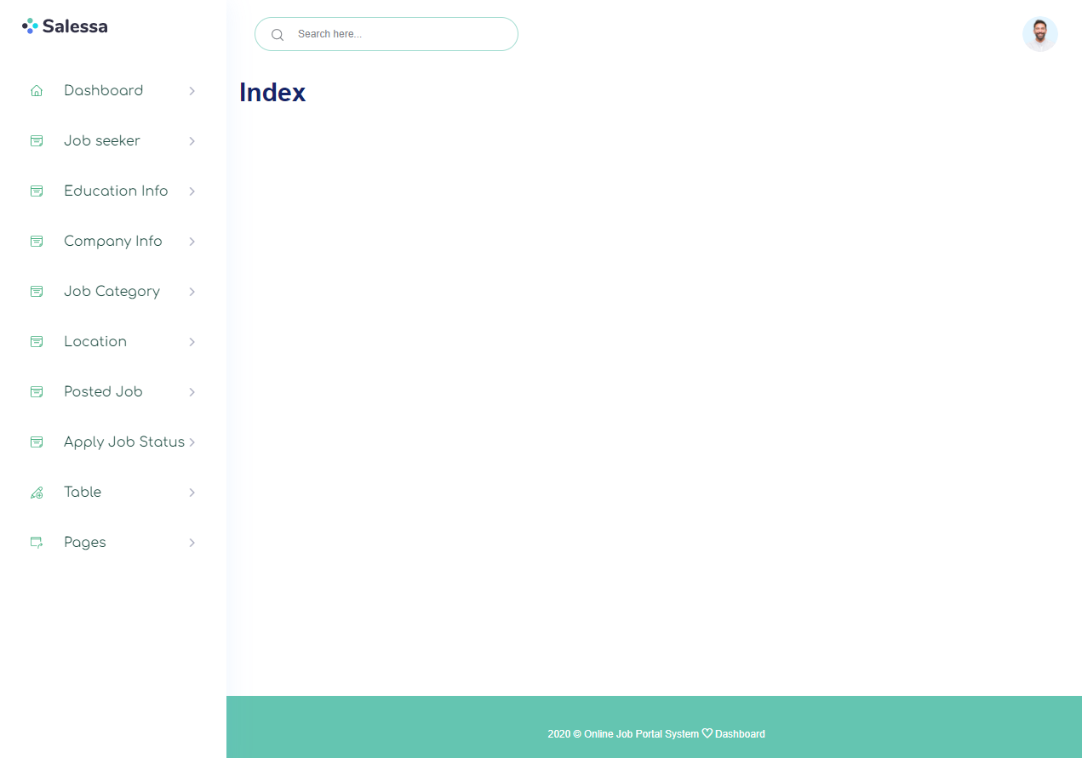
Admin Dashboard

Slide 13
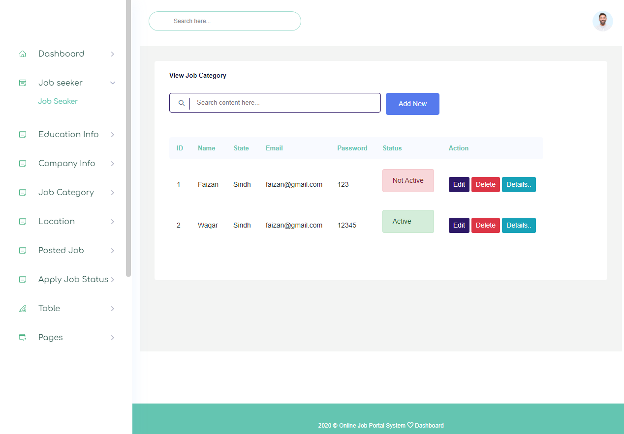

Slide 14
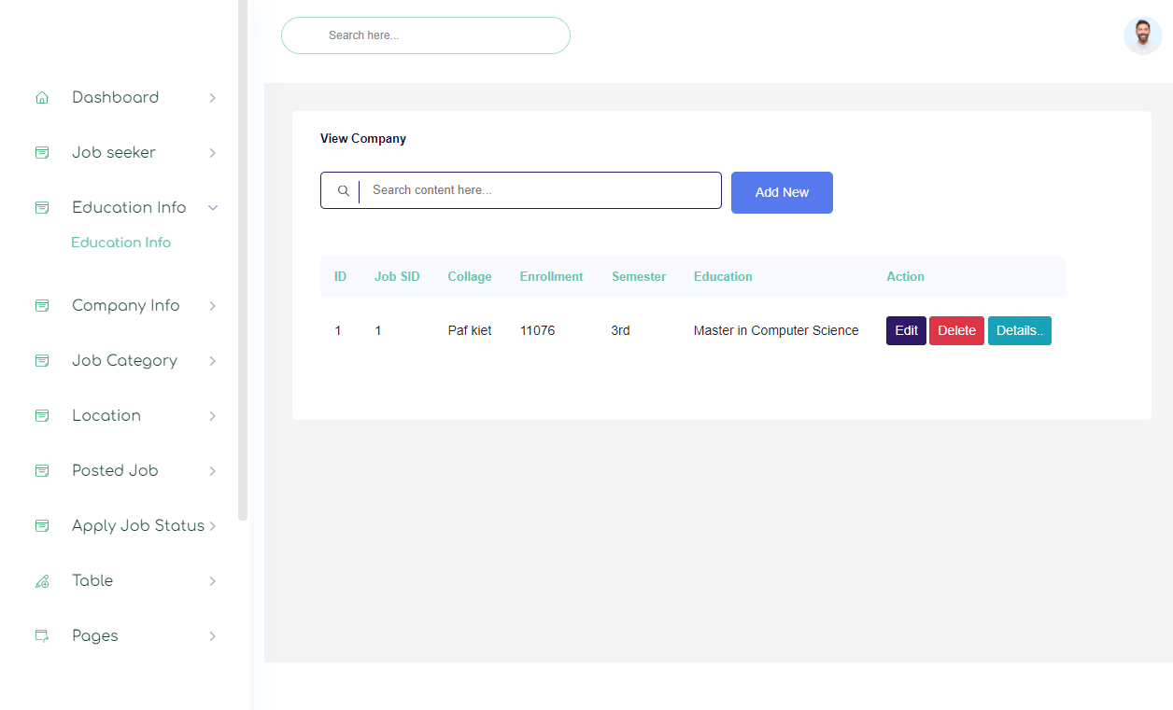

Slide 15
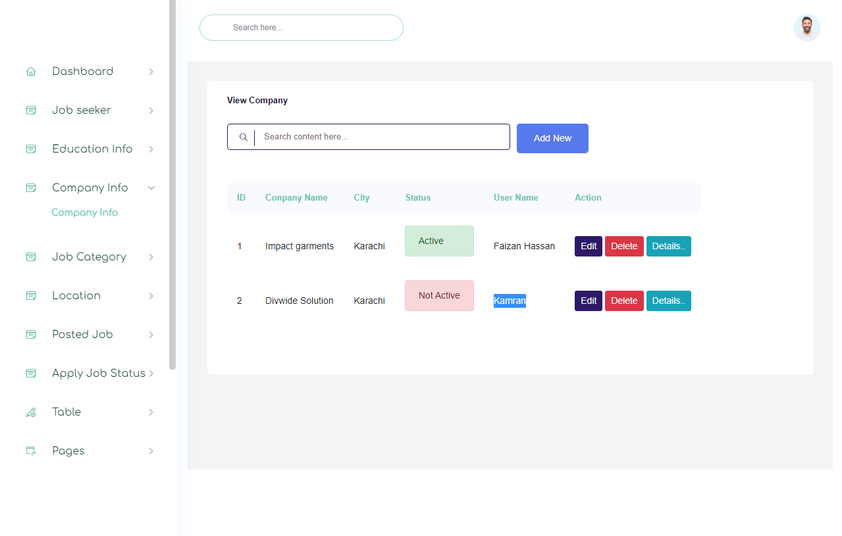

Slide 16
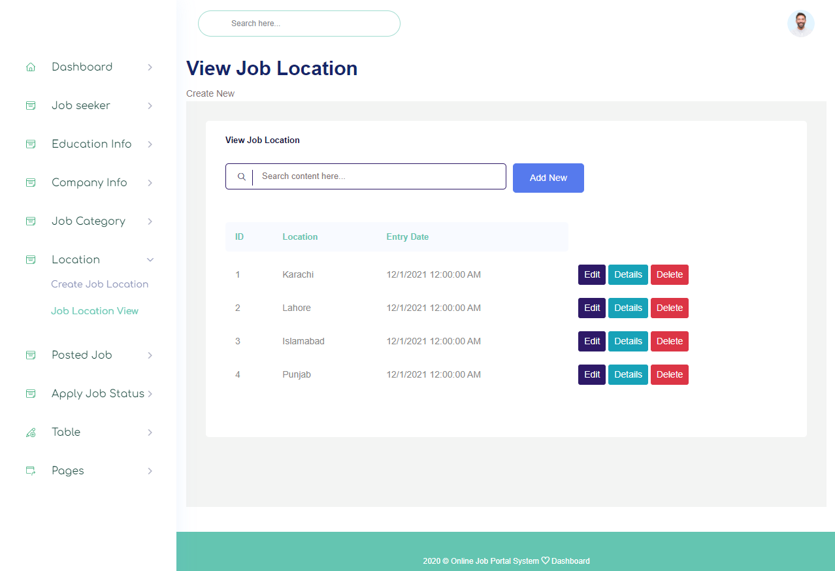

Slide 17
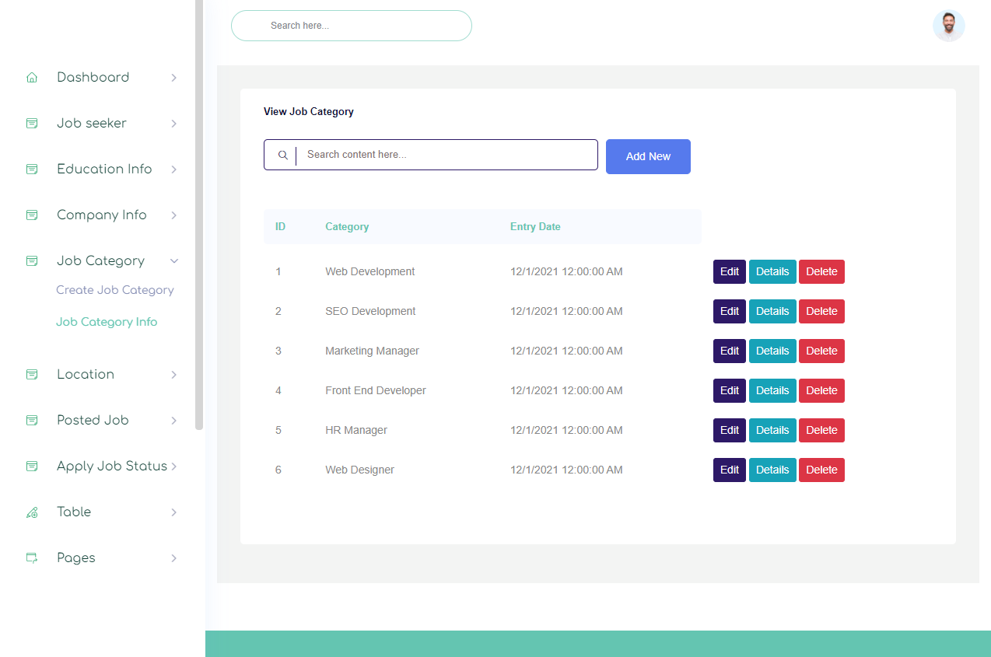

Slide 18
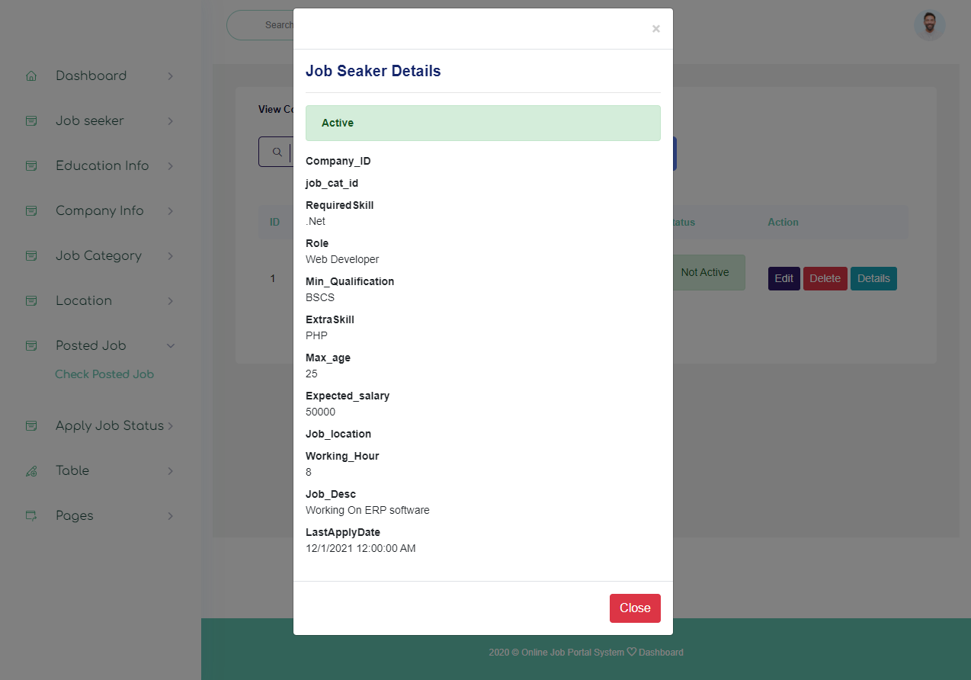

Slide 19
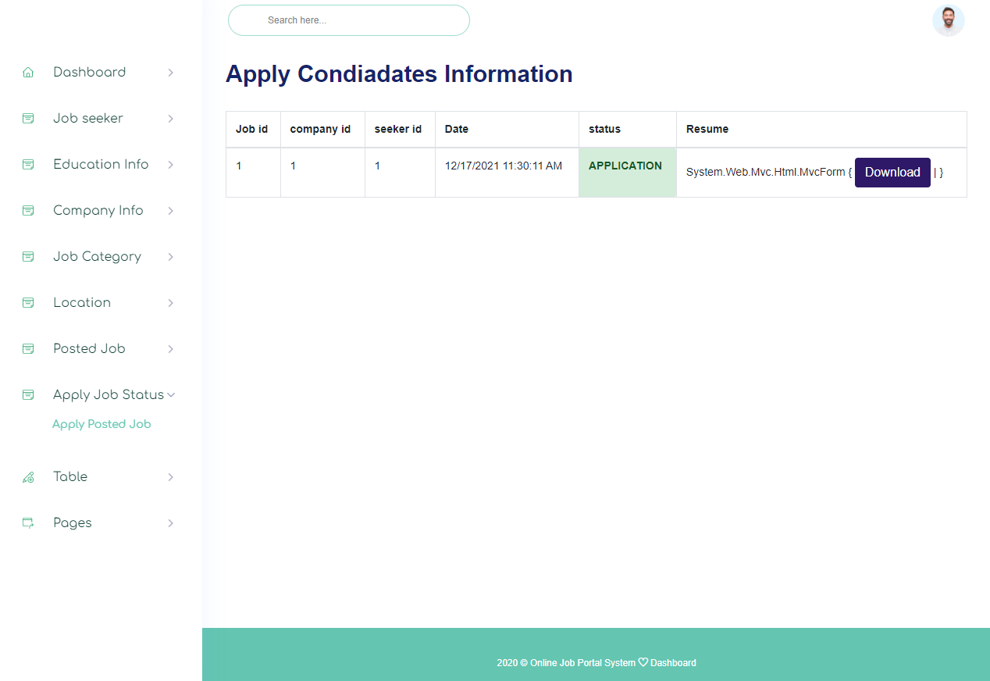

Slide 20
